Slide 1


Artificial Intelligence in Software Engineering
Xusheng Xiao
North Carolina State University
CSC 720 Project Presentation

Slide 2
Software Engineering (SE)
Software Engineering (SE) is a knowledge-intensive activity, presumably requiring intelligence
Software Testing
Program Analysis
Debugging
Artificial Intelligence (AI) techniques are used to reduce human efforts in SE activities
assist or automate various activities of software engineering

Slide 3
Example AI Techniques used for SE Activities
AI in software testing
prune search space for automatic test generation
AI in fault detection
apply machine learning on data-flow analysis for fault detection
AI in software repair
apply generic programming to automatically find patches for programs

Slide 4
Automated Software Testing
Structural testing is a widely used software testing technique
test internal structures of a program (i.e., white-box testing)
measure achieved structural coverage, e.g.,
Statement/Block Coverage
Branch Coverage
Achieving at least high structural coverage is an important goal of structural testing
developers/testers manually produce test inputs
tools automatically generate test inputs
Notes:
In order to adequately test software, a number of different testing techniques must be performed.
One class of testing techniques used extensively is structural testing in which properties of the software code are used to ensure a certain code coverage.
The tester chooses inputs to exercise paths through the code and determine the appropriate outputs.
High structural coverage can be used to detect insufficiency of the test cases

Slide 5
Symbolic Execution in Software Testing
Symbolic execution track programs symbolically rather than executing them with actual input value
track program input symbolically
collect constraints in the program
Dynamic Symbolic Execution (Concolic testing) systematically explore program paths to generate inputs
combine both concrete and symbolic execution
use constraint solver to obtain new inputs

Slide 6
Dynamic Symbolic Execution (DSE)
Choose next path
Code to generate inputs for:
Solve
Execute&Monitor
void CoverMe(int[] a)
{
if (a == null) return;
if (a.Length > 0)
if (a[0] == 1234567890)
throw new Exception("bug");
}
Constraints to solve
a!=null
a!=null &&
a.Length>0
a!=null &&
a.Length>0 &&
a[0]==1234567890
Data
null
{}
{0}
{123…}
Observed constraints
a==null
a!=null &&
!(a.Length>0)
a!=null &&
a.Length>0 &&
a[0]!=1234567890
a!=null &&
a.Length>0 &&
a[0]==1234567890
Negated condition
a==null
F
T
a.Length>0
F
T
Done: There is no path left.
a[0]==123…
F
T
[Tillmann et al. TAP 08]

Slide 7
Path Explosion in DSE
In theory, DSE can explore all paths of a program eventually
The number of paths in a program increases exponentially on number of branches
In practice, it is impossible to explore all paths of a program

Slide 8
Heuristics in Assisting DSE
Often the case, it is enough to achieve certain structural coverage of the program
statements
branches
atomic predicates
There is an mismatch between path-based coverage and such structural coverage goals
achieve new path coverage, but no new structural coverage
propose three heuristics to address this issue

Slide 9
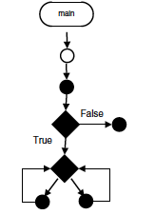
Look-Ahead heuristic
Perform a reachability analysis in terms of reachable items in the CFG
Decide whether the current path must be expanded based on the reachability analysis
If no new items can be reached, then exploration along the current path is stopped.

Slide 10
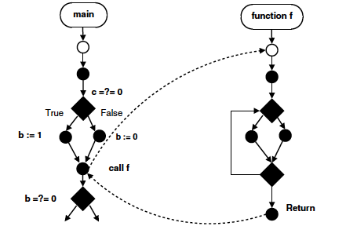
Max-Call Depth (MCD) heuristic
The principle of the Max-Call Depth heuristic (MCD) is to prevent backtracking in deep nested calls
MCD may discard relevant paths and prevent the full coverage of the function under test.
On some programs MCD can discard many paths and still achieve full coverage.

Slide 11
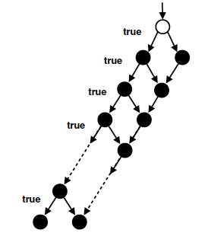
Solve-First (SF) heuristic
all alternative successors of a path are immediately resolved.
Along a path, shorter and potentially simpler prefixes are resolved before longer ones.
Some paths of the programs very distant from the first path are resolved quickly, allowing for potential faster initial coverage.

Slide 12
Software Fault, Error, and Failure
A software fault (also called bug) refers to a static defect in the software.
A software fault may result in an incorrect internal state, which is referred to as software error.
If the software error is propagated to the output of the software, and results in incorrect behaviors with respect to the requirements or other description of the expected behavior, a software failure occurs

Slide 13
Fault Detection
Detect faults in program is a difficult task
software complexity and size grows quickly
concurrent faults depends on thread interleaving
semantic faults is program specific
missing the reassignment of some variables
incorrectly reuse some variables
There is a strong need in automate such task

Slide 14
Automatically Identify Faults Using Definition-Use Invariants
Regardless of the causes of all these faults, they all share a common characteristics incorrect data flow
a read instruction uses the value from an unexpected definition
Automatically detect faults by detecting such incorrect definition-use data flow

Slide 15
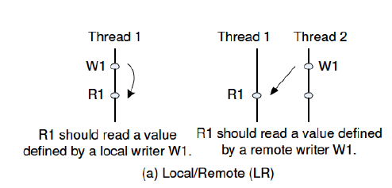
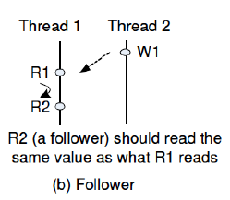
Definition-Use Invariants - 1
Local/Remote (LR) Invariants
Follower Invariants

Slide 16
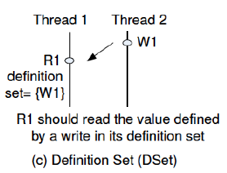
Definition-Use Invariants - 2
Definition Set (DSet) Invariants

Slide 17
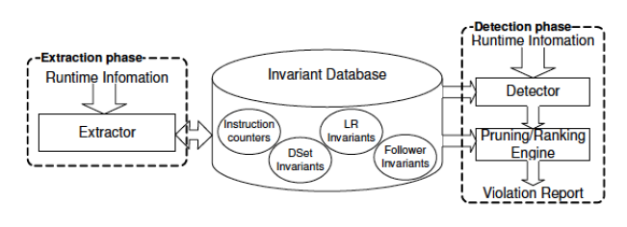
Overview of Approach

Slide 18
AI in Software Repair
Manual fault fixing is a difficult, time-consuming, labor-intensive process.
Automated approach is needed to reduce human efforts
Apply generic programming to automatically find patches for fixing programs

Slide 19
Generic Programming (GP)
GP operates on and maintains a population comprised of different programs
The fitness, or desirability, of each chromosome, is evaluated via an external fitness function.
Variations are introduced through mutation and crossover.
These operations create a new generation and the cycle repeats.

Slide 20
Program Representation
An abstract syntax tree(AST) including all of the statements in the program
A weighted path through the program under test.
The weighted path is a list of pairs, each pair containing a statement in the program and a weight based on that statements occurrences in various test cases.

Slide 21
Key Insights
Restrict the algorithm to only produce changes that are based on structures in other parts of the program.
hypothesize that a program that is missing important functionality (e.g., a null check) will be able to copy and adapt it from another location in the program.
Constrain the genetic operations of mutation and crossover to operate only on the region of the program that is relevant to the error
the portions of the program that were on the execution path that produced the error

Slide 22
Approach using GP
Use GP to maintain a population of variants of a program
Modifies variants using two genetic algorithm operations, crossover and mutation
Evaluates the fitness of each variant
a weighted sum of the positive and negative test cases it passes.
Their approach stops when a program variant that passes all of the test cases is found.

Slide 23
Conclusion and Questions
AI in software testing
prune search space for automatic test generation
AI in fault detection
apply machine learning on data-flow analysis for fault detection
AI in software repair
apply generic programming to automatically find patches for programs

Slide 24

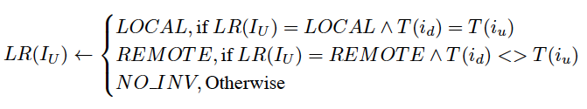
Invariant Extraction
DSet invariant extraction
LR invariant extraction
Follower invariant extraction

Slide 25

Fault Detection
DSet invariant violation
LR invariant violation
Follower invariant violation

Slide 26


Pruning and Ranking
Pruning
barely exercised uses
barely exercised definitions
popular uses
Ranking

